Slide 1

3D Shapes

Slide 2
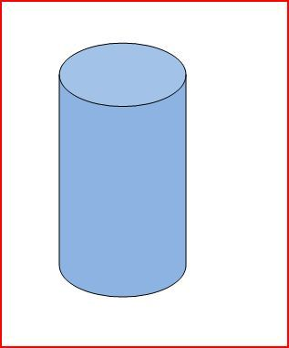
1) Answer the following questions about the shape below:
What shape is this?
How many faces does it have?
How many vertices does it have?
This Photo by Unknown Author is licensed under CC BY-SA

Slide 3
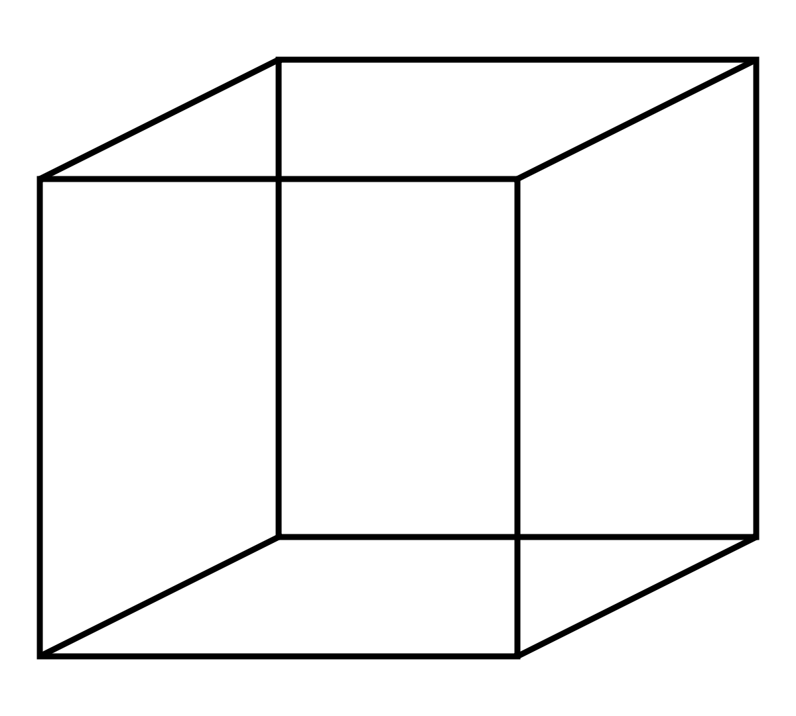
2) Answer the following questions about the shape below:
What shape is this?
How many faces does it have?
How many vertices does it have?
This Photo by Unknown Author is licensed under CC BY-SA

Slide 4
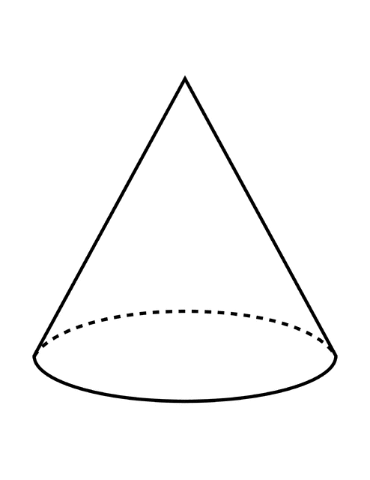
3) Answer the following questions about the shape below:
What shape is this?
How many faces does it have?
How many vertices does it have?
This Photo by Unknown Author is licensed under CC BY-SA

Slide 5
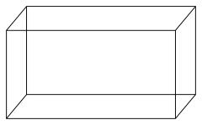
4) Answer the following questions about the shape below:
What shape is this?
How many faces does it have?
How many vertices does it have?
This Photo by Unknown Author is licensed under CC BY-SA

Slide 6
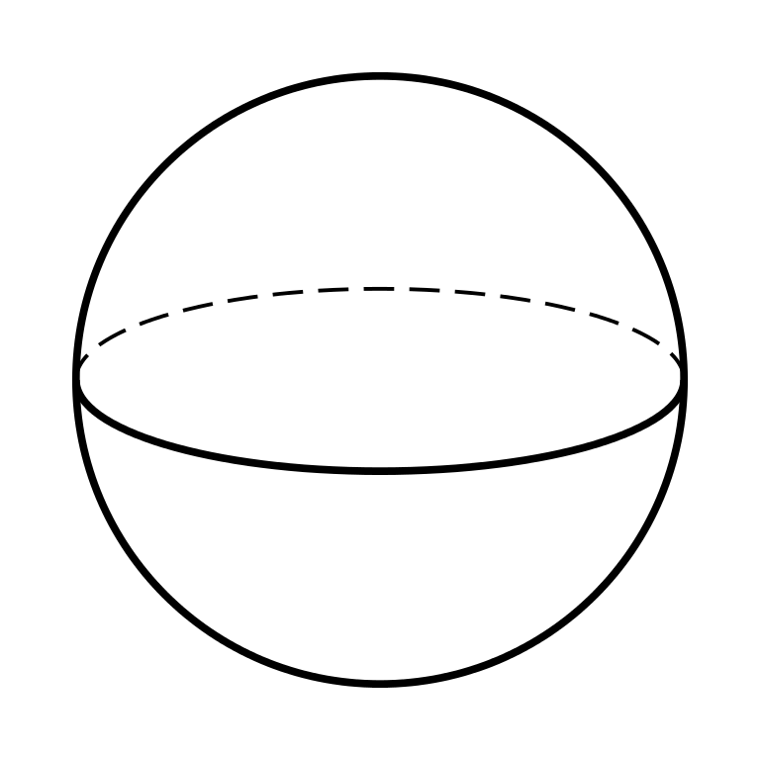
5) Answer the following questions about the shape below:
What shape is this?
How many faces does it have?
How many vertices does it have?
This Photo by Unknown Author is licensed under CC BY-SA

