Slide 1
Ocean Animals

Slide 2


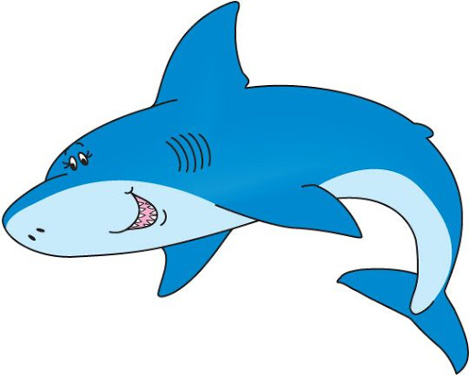
Dolphin
Whale
Shark
Notes:
This Photo by Unknown Author is licensed under CC BY-NC (Dolphin Photo)
This Photo by Unknown Author is licensed under CC BY-NC-ND (Whale Photo)
This Photo by Unknown Author is licensed under CC BY-SA-NC (Shark Photo)

Slide 3
Questions
How many more whales are there than dolphins?
How many more whales are there than sharks?
How many more sharks are there than dolphins?
Write a question about the picture graph.

Slide 4
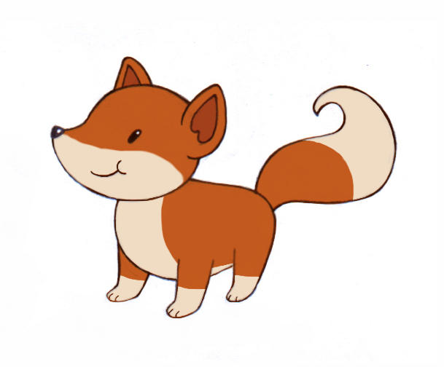
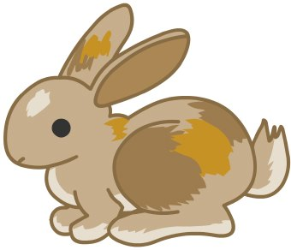
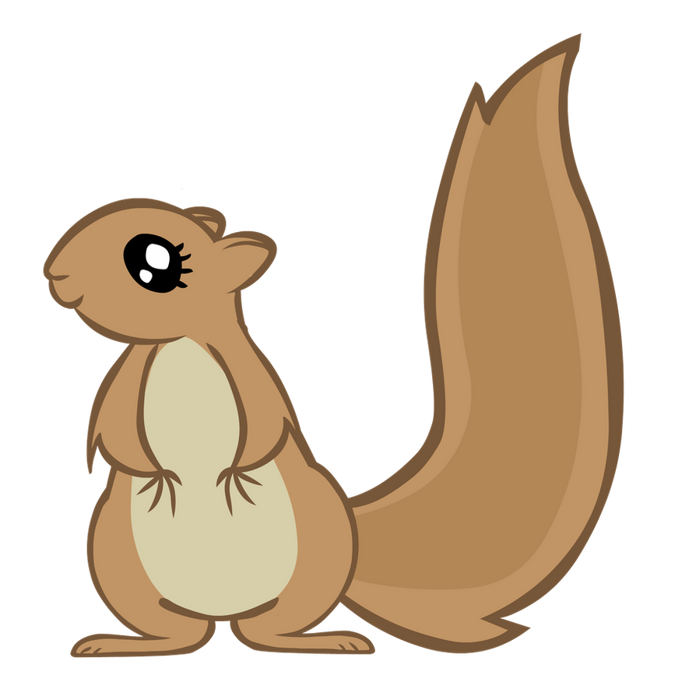
Fox
Rabbit
Squirrel
Notes:
This Photo by Unknown Author is licensed under CC BY-SA (fox photo)
This Photo by Unknown Author is licensed under CC BY-ND (rabbit photo)
This Photo by Unknown Author is licensed under CC BY (Squirrel photo)

Slide 5
Questions
How many more foxes are there than bunnies?
How many more foxes are there than squirrels?
How many more bunnies are there than squirrels?
Write a question about the picture graph.

