Slide 1

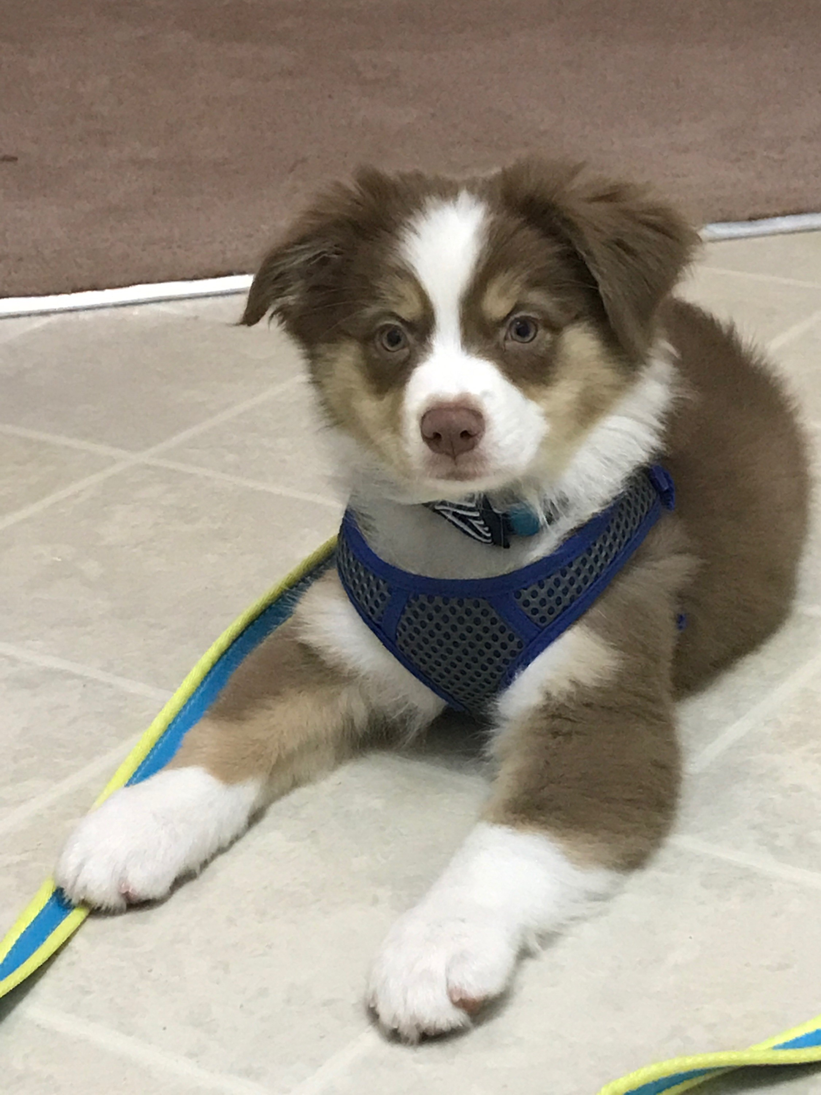
Teach Riley fractions
What are fractions? I hope someone can help me learn about them.

Slide 2
directions
Draw each shape on a separate piece of paper to show Riley how to properly partition the shapes.

Slide 3
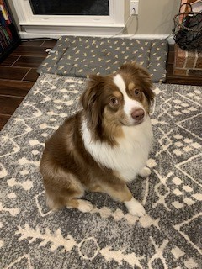
Riley has been doing fractions incorrectly.
Help her fix her fractions.
Riley thinks this is equally partitioned in half. Can you help her correct this?

Slide 4
Riley has been doing fractions incorrectly.
Help her fix her fractions.
Riley thinks this is partitioned correctly in halves. Can you help her correct this?

Slide 5
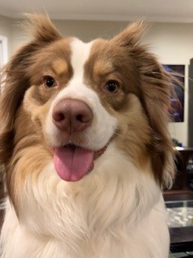
Riley has been doing fractions incorrectly.
Help her fix her fractions.
Riley thinks this is partitioned equally in halves. Can you help her correct this?

Slide 6
Riley has been doing fractions incorrectly.
Help her fix her fractions.
Riley thinks this is partitioned into four equal parts. Can you help her correct this?

Slide 7
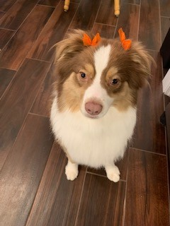
Riley has been doing fractions incorrectly.
Help her fix her fractions.
Riley thinks this is partitioned into four equal parts. Can you help her correct this?

Slide 8
Riley has been doing fractions incorrectly.
Help her fix her fractions.
Riley thinks this is partitioned into four equal parts. Can you help her correct this?

Slide 9
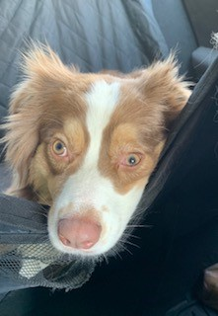
Riley has been doing fractions incorrectly.
Help her fix her fractions.
Riley thinks this is partitioned into four equal parts. Can you help her correct this?

Slide 10
Riley has been doing fractions incorrectly.
Help her fix her fractions.
Riley thinks this is partitioned into four equal parts. Can you help her correct this?

Slide 11
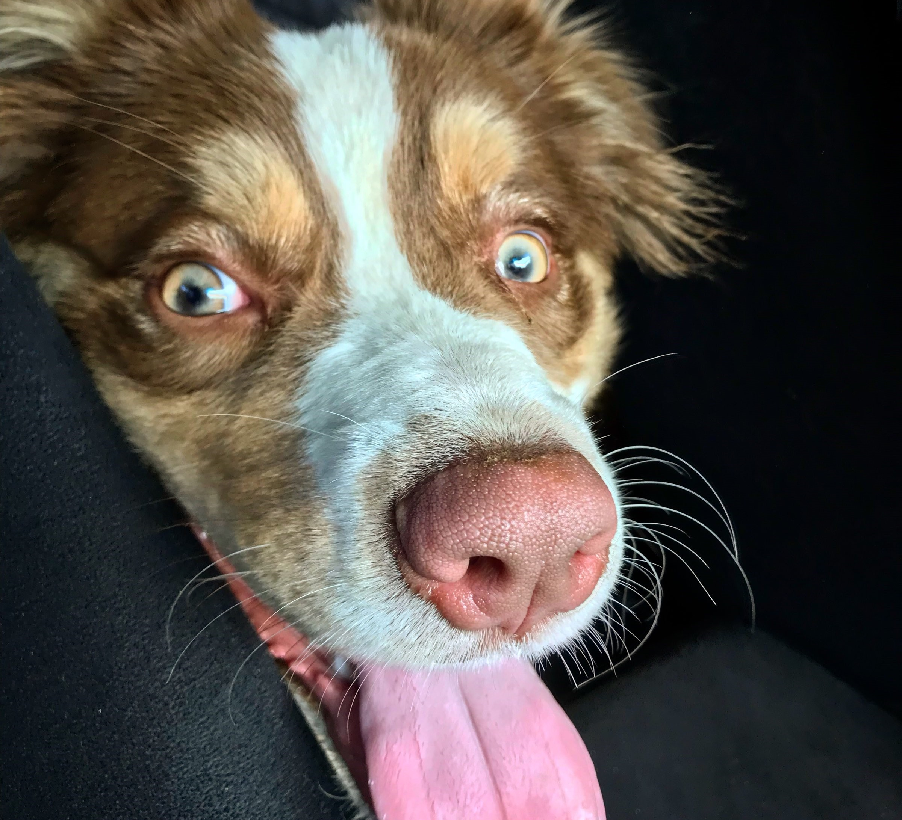
Riley says thank you so much for helping her with fractions!

