Slide 1

Creating 3D Shapes out of 2D Shapes

Slide 2
1) What 3D shape would the following 2D shapes make?

Slide 3
2) What 3D shape would the following 2D shapes make?

Slide 4
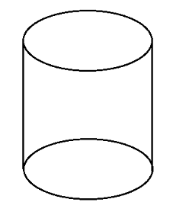
3) What 2 2D shapes are found in a cylinder?
This Photo by Unknown Author is licensed under CC BY-SA

Slide 5
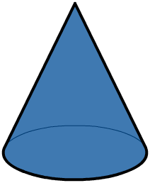
4) What 1 2D shapes are found in a cone?
This Photo by Unknown Author is licensed under CC BY-NC

Slide 6
If given time play the following game:
Magical Shape Hunt
https://pbskids.org/peg/games/magical-shape-hunt

