Slide 1
Pictograph

Slide 2
Example Data
Favorite Animal
Dogs | 5
Cats | 4
Bunnies | 2

Slide 3
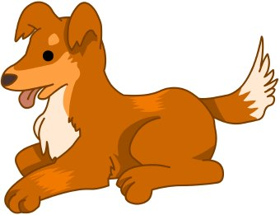
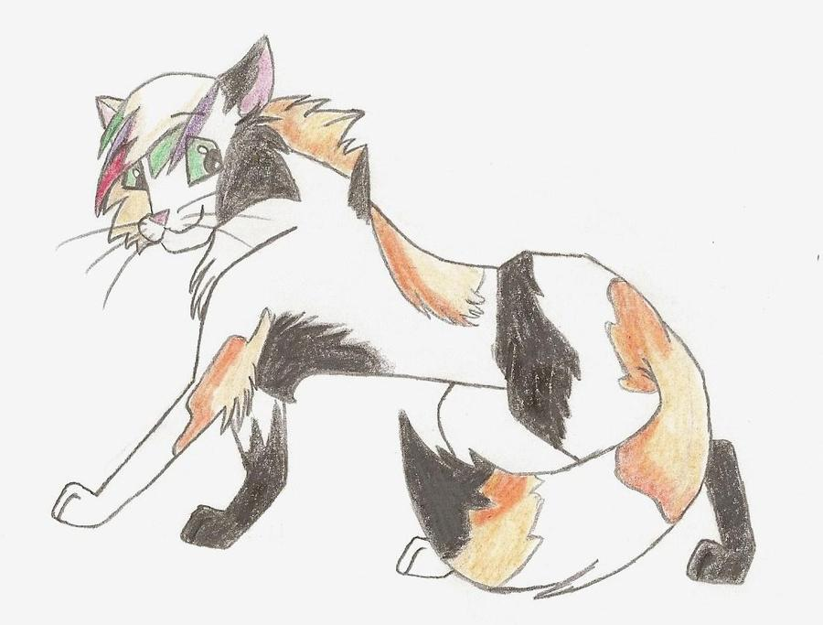
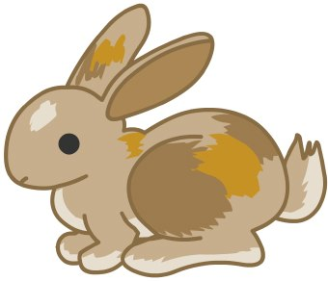
Example How to Use the Data to Create a Pictograph
____Favorite Animals______________________
(Title)
Dogs | Cats | Bunnies
Key __1 Animal Picture____ = 1 vote
Notes:
This Photo by Unknown Author is licensed under CC BY-ND (dog photo)
This Photo by Unknown Author is licensed under CC BY-NC-ND(Cat drawling)
This Photo by Unknown Author is licensed under CC BY-ND (Bunny picture)

Slide 4
Now you try with the data below. You can either use PowerPoint, SeeSaw, or draw the animals on a piece of paper.
Favorite Animal
Birds | 4
Snakes | 8
Wolves | 6

